Slide 1
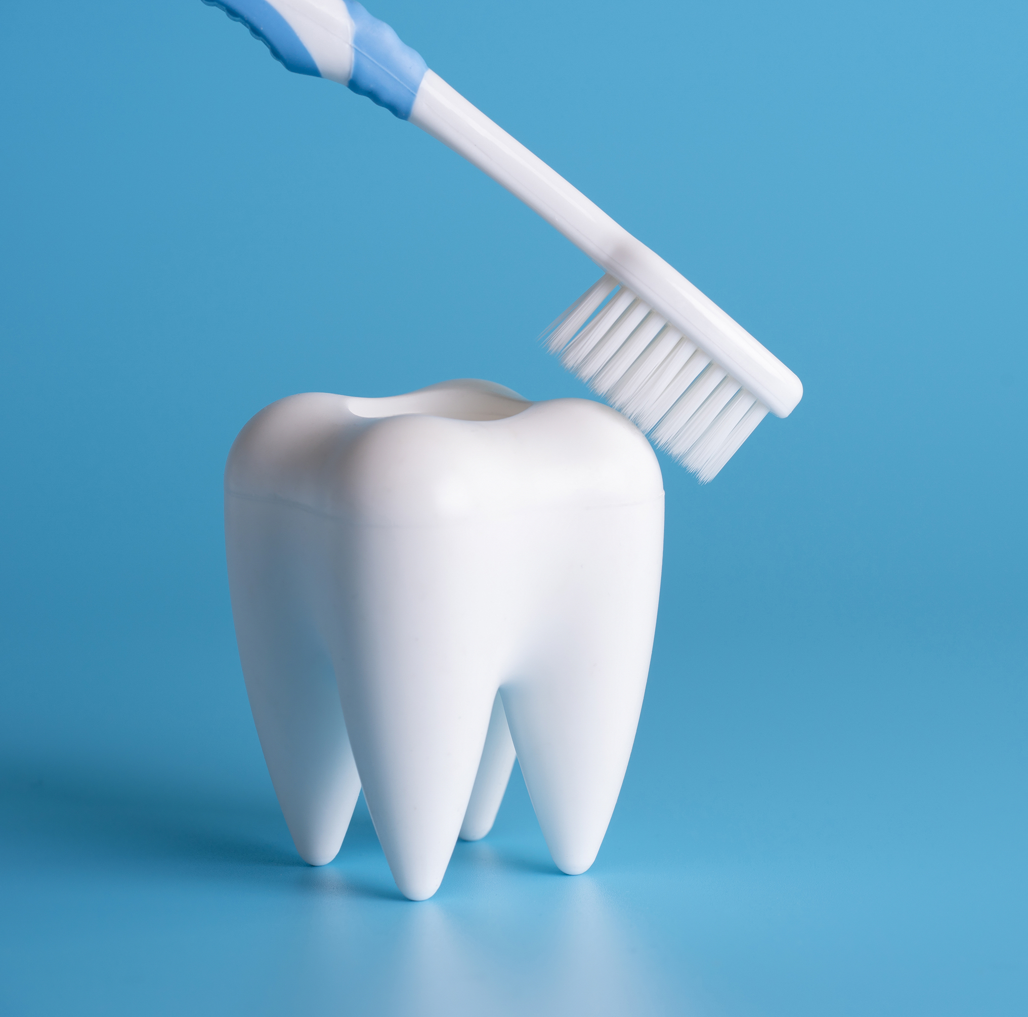
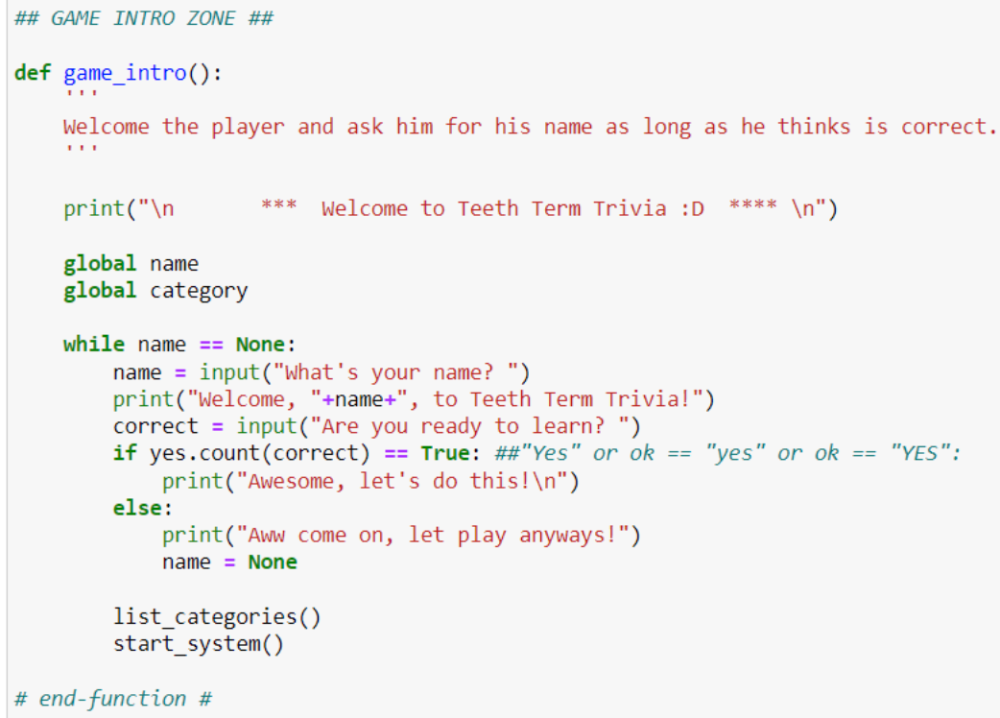
Teeth Term Trivia
By Nicole Ogbuagu, Ashana Vaudreuil, Jazmyne Lane, and Ziyah Anderson
https://github.com/ksu-hmi/Teeth-Term-Trivia
Learn dental terms in fun way!

